Slide 1
A STUDY ON LANE UTILIZATION
Branch of study: Transportation Engineering
Batch: A15
Broad area of work: A study on lane utilization
Name of the Project Guide: Mr. G. Rahul Reddy
Name(s) of the project team members:
M. Kanaka Mahalakshmi(18331A0159)
B. Yoshita(18331A0106)
K. N. V. Satyam(18331A0151)
S. Chakri Pavan Kumar(18331A0114)
Department of Civil Engineering,
Maharaja Vijayaram Gajapathi Raj college of engineering(A)

Slide 2
Table of contents
Problem statement
Objective
Scope
Broad area of work
Literature review
Data collection
Data analysis
Results
Summary

Slide 3
Problem statement
The inconsistency of traffic flow behaviour on uninterrupted freeways might largely affect the traffic assignment system.
This research paper has been done to understand the undulations in traffic flow and the efficiency of lane distribution system over the speculated area of study, i.e., two National Highways in the districts of Visakhapatnam and Vizianagaram.

Slide 4
Objective
To study lane discipline and lane utilization behavior for different categories of vehicles on various national highways.
To compare the results of lane utilization factors for different lanes and vehicles observed on the road.
To model lane utilization using parameters like classified traffic volume and average stream speed for prevailing roadway and traffic conditions on the selected area of study.

Slide 5
Scope
For this purpose, two locations each in the districts of Vizianagaram and Visakhapatnam along the highways NH-16, NH-26 have been considered.
The locations taken for the study are Boyapalem(NH-16,VSP), Ghambiram(NH-16,VSP), Jonnada(NH-26,VZM), Police barracks area(NH-26,VZM).
The different vehicle categories considered for the study are car, two-wheeler, three-wheeler, heavy good vehicle (i.e. bus and trucks).

Slide 6
Broad area of work
The project falls under the category of Transportation planning, a subset of civil engineering where the modelling for multi-lane roads can be done using lane utilization factors.
The lane utilization factor, f_{LU}, is defined as the ratio of the average volume per lane to the volume in the heaviest used lane.

Slide 7
Broad area of work
The traffic data is collected and analyzed considering the lane utilization, flow rates, classified volume count, speed of individual vehicle along with stream speeds and its composition is used to explain lane-wise lane usage behavior.
A comparative evaluation of lane distribution for each lane and each vehicle category will be presented in the form of pie charts and bar charts.

Slide 8
Literature review
Lane-Distribution Models and Related Effects on the Capacity for a Three-Lane Freeway Section: Case Study in Italy
One of the first studies on the lane distribution for multi-lane carriageways was that by the US Public Roads Administration (Normann, 1942). In these studies, the non-homogeneous use of a multilane road was highlighted, along with the observation that the percentage of use of the shoulder lane was inversely proportional to the total flow.
With increasing flow, vehicles seemed to prefer the middle or median lanes. The first multiple regression models were proposed in these studies to fit the functional formulation of lane use percentage, known as Lane Flow Ratio (LFR).

Slide 9
Literature review
Study of Lane Utilization on Delhi-Gurgoan expressway by Sagar Kurle, Krishna Nikhil Sumanth Behara, J. Rajendra Prasad, Shriniwas Shrikant Arkatkar, Published on December 2016
The lane utilization is affected by several factors such as vehicle composition, traffic flow rate and vehicular speeds. In the present study, eight hours of video graphic data was collected from a road stretch on Delhi-Gurgaon Expressway, incorporating both peak and off peak hours.
The results of the present study in the form of lane utilization and lane discipline behavior by different vehicle types may help in differentiating the characteristics of traffic on expressways in relation to the other roads in India. It may be also helpful to refine the microscopic simulation models and its parameters in order to validate them at micro-level, under traffic conditions prevailing on Delhi-Gurgaon Expressway.

Slide 10
Literature review
Study of Speed-Flow Relationships on Individual Freeway Lanes
In this study, the relationship was examined for each of the three lanes at two locations on Highway 401 in metropolitan Toronto. It proved possible to accurately describe the mean speed in each lane with simple linear functions over the range of flows of most practical interest.
When an attempt was made to examine the relationship between speed and flow for the entire roadway, the linear functions were not adequate, but cubic functions performed reasonably well. The curves described in the manual are much steeper than the Highway 401 curves at high flows, implying a much more rapid loss of performance as flow approaches capacity than was observed.

Slide 11
Data collection
The area of work is classified using lane distribution system respectively.
The lanes are distributed as lane 1, lane 1.5, lane 2, lane 2.5 and so on.
The selection of time interval was done in such a way to cover a wider range of variation in traffic flow conditions
The work is done by tallying the number of different category of vehicles passing at an instantaneous cross section of the lane.

Slide 12
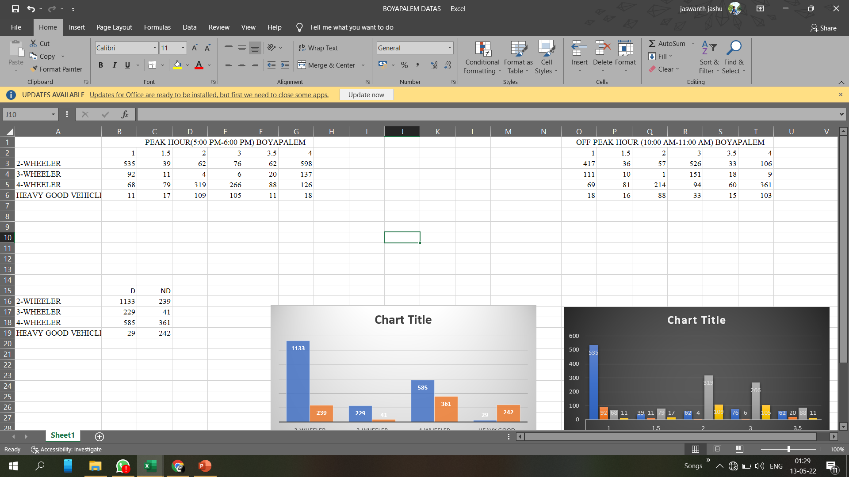
Data on lane distribution of different categories of vehicles collected on the area of work: Boyapalem.

Slide 13
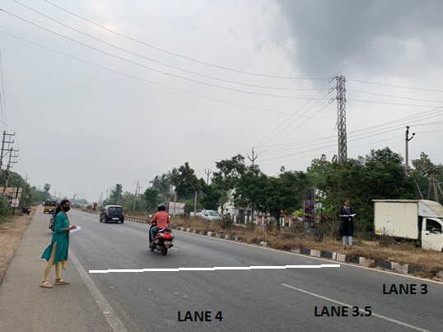
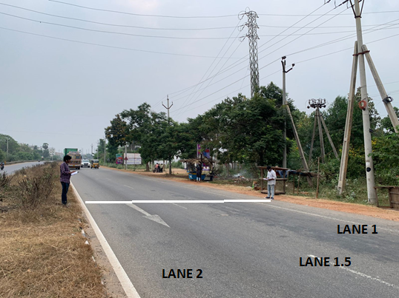
NH16 BOYAPALEM AREA 4 LANE ROAD

Slide 17
LUF at NH16 BOYAPALEM
Lane | Total Volume | LUF
1 | 706 | 0.8
2 | 494 | 0.562
3 | 453 | 0.515
4 | 879 | 1

Slide 18
Data on lane distribution of different categories of vehicles collected on the area of work : Gambhiram

Slide 19
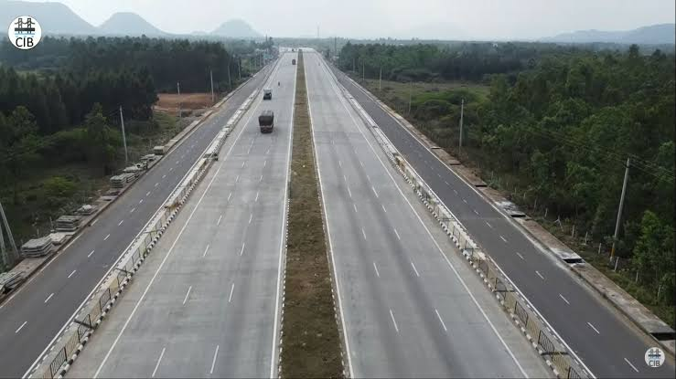
ANANDAPURAM-PENDURTHI HIGHWAY(NH5/new NH16)
SL
1
2
3
4
5
6
SL
1.5
2.5
4.5
5.5

Slide 23
LUF at Ghambiram
Lane | Total Volume | LUF
1 | 52 | 0.75
2 | 69 | 1
3 | 69 | 1
4 | 56 | 0.81
5 | 67 | 0.97
6 | 45 | 0.65

Slide 24
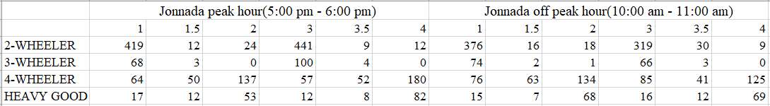
Data on lane distribution of different categories of vehicles collected on the area of work: Jonnada.

Slide 28
LUF at Jonnada
Lane | Total Volume | LUF
1 | 568 | 0.93
2 | 214 | 0.35
3 | 274 | 0.44
4 | 610 | 1

Slide 29
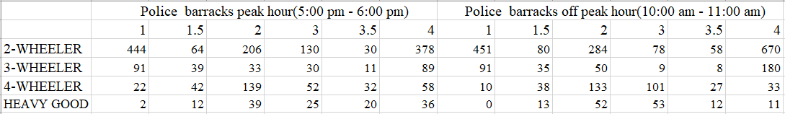
Data on lane distribution of different categories of vehicles collected on the area of work: Police barracks.

Slide 30
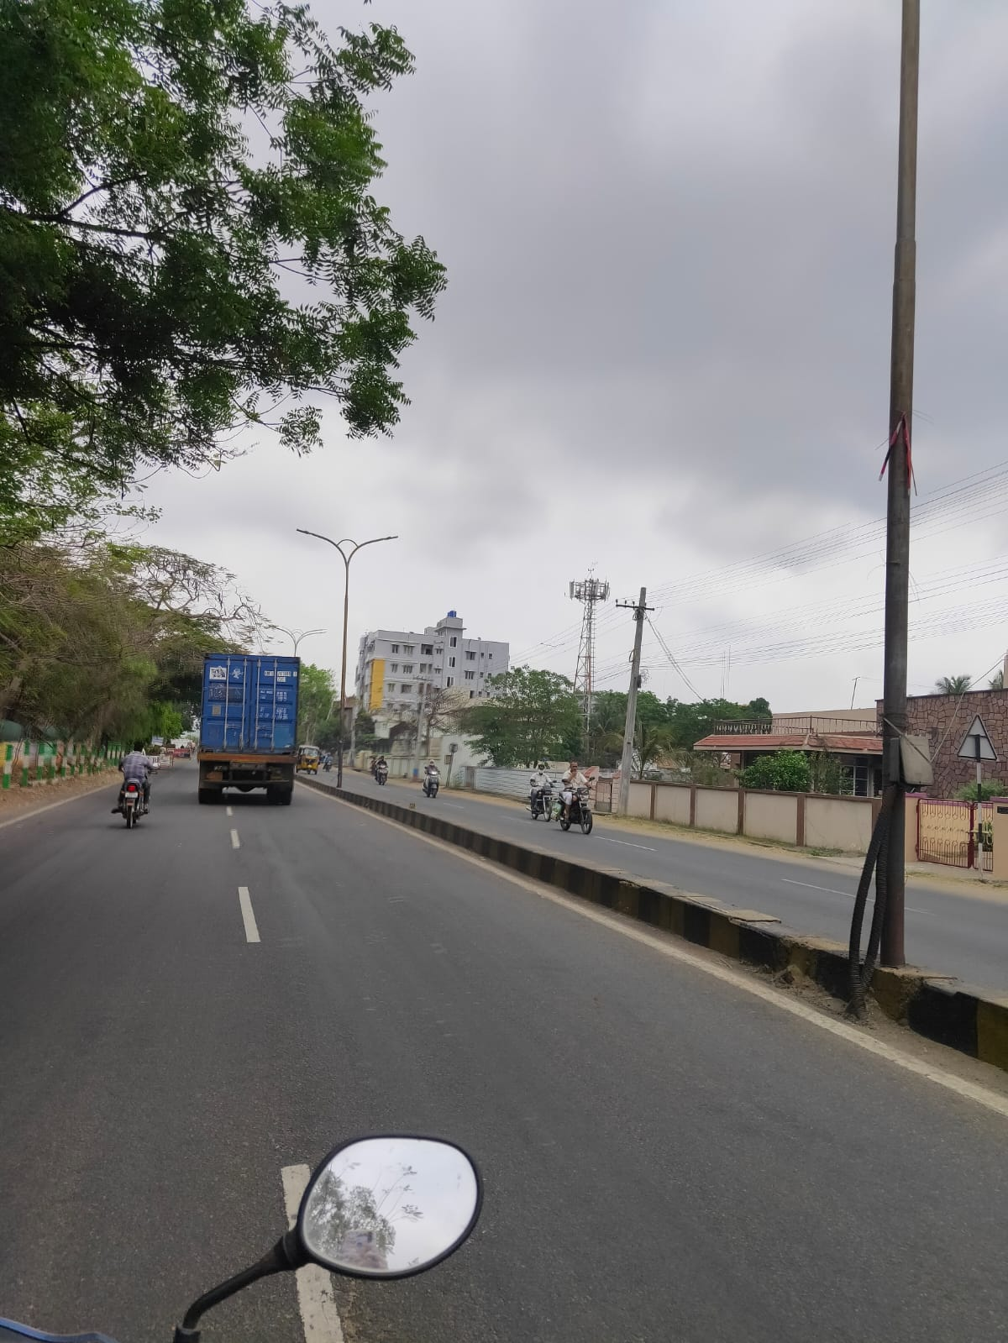
NH26 POLICE BARRACKS AREA 4 LANE ROAD

Slide 34
LUF at Police barracks
Lane | Total Volume | LUF
1 | 559 | 0.99
2 | 417 | 0.74
3 | 237 | 0.422
4 | 561 | 1

Slide 35
Data analysis
The share of vehicles among different lanes is depicted in the descriptive statistics.
Because of smaller size, all the two-wheelers are found to follow lane-discipline.
Also, it may be noted that there are significant number of cars which do not follow perfect lane-discipline.
The heavy vehicles tend to follow lane discipline and travel in the lanes away from the shoulder.

Slide 36
Results
The lane discipline is concerned, two-wheelers 97.1%, 78.5%, 93.7%, 65.6%, three-wheeler 84.8%,100%, 96%, 61.4%, four-wheeler 94.9%, 70%, 58.7%, 55.3%, Heavy Good Vehicles 10.7%, 7.4%, 15.7%, 28.3% at Boyapalem, Ghambiram, Jonnada, Police Barracks respectively follow the lane discipline.
The Lane Utilization Factors at Boyapalem breaks down to 0.8, 0.562, 0.515,1 and at Ghambiram 0.75, 1, 1, 0.81, 0.97, 0.65, at Jonnada the LUF is 0.93, 0.35, 0.44, 1 and at Police Barracks 0.99, 0.74, 0.422, 1 at lanes 1, 2, 3 and 4 (5 and 6 lanes at Ghambiram) respectively.

Slide 37
Summary
The following are the important findings of the study:
Because of smaller size, all the two-wheelers are found to follow lane-discipline. In a single designated lane, the parallel movement of two two-wheelers was observed simultaneously, which may be possible only by virtue of their smaller size.
It is observed that there are significant number of cars, three-wheelers and heavy vehicles which do not follow perfect lane-discipline. But, this observed degree of lane based vehicle movement is relatively different as compared to the other multilane roads (National Highways, urban arterial roads, etc.) in India.
It is also found that the proportion of cars linearly decreases from median side lane to shoulder side lane i.e. from lane-1 to lane-4, whereas the proportion for two-wheelers, three-wheelers, trucks and buses linearly increases from lane-1 to lane-4.

Slide 38
4. It is found that the median-side lane is occupied most of the times by cars and the shoulder side lane is occupied by two-wheelers and heavy vehicles most of the times. This may be attributed to the faster movement of cars over relatively slow moving vehicles like two-wheelers, bus and trucks.
5. It is observed that at all the selected locations heavy good vehicles especially trucks have shown (more than 80%) non-disciplinary behaviour. This may be attributed to the fact that most of the Indian truck drivers are unaware and negligent of the general traffic rules and regulations.
6. In urban locations like Boyapalem, Jonnada proper lane utilisation by all vehicle categories is achieved and there is future scope for development of better transport facilities such as improved public transportation, further urban arterial road development etc.
The results of the present study may be useful for getting a better understanding of lane usage at aggregate level. The results may be also useful by formulating an analysis framework for vehicle lateral placement and vehicle movement components in traffic simulation model for multilane urban roads with high speeds.

Slide 39
Thank you!

